Slide 1
Module 6 – Statistical Power and Sample Size

Slide 2
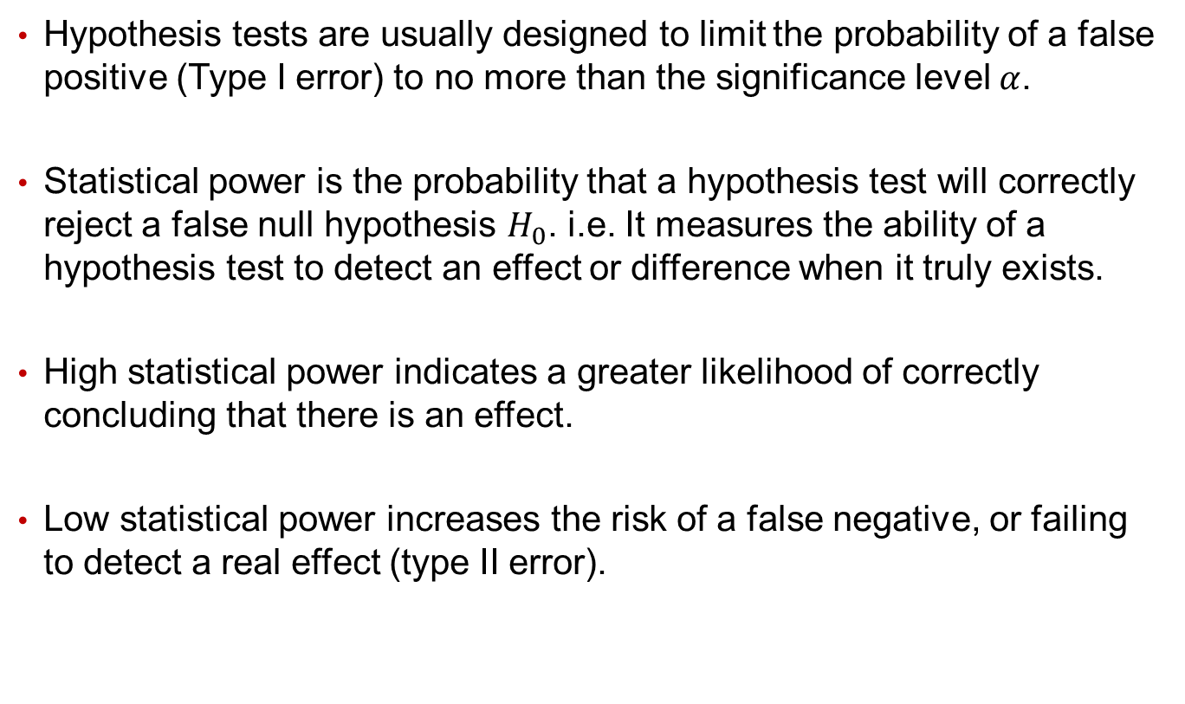
Statistical Power
Hypothesis tests are usually designed to limit the probability of a false positive (Type I error) to no more than the significance level $α$.
Statistical power is the probability that a hypothesis test will correctly reject a false null hypothesis $H_{0}$. i.e. It measures the ability of a hypothesis test to detect an effect or difference when it truly exists.
High statistical power indicates a greater likelihood of correctly concluding that there is an effect.
Low statistical power increases the risk of a false negative, or failing to detect a real effect (type II error).

Slide 3
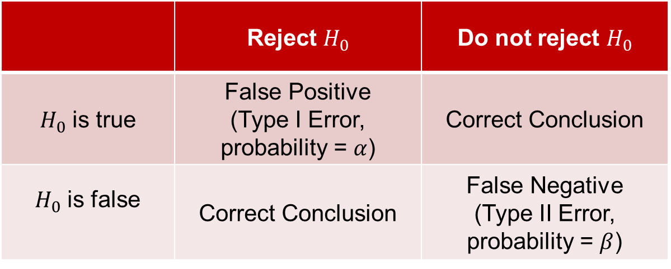

Statistical Power
Recall that all hypothesis tests assume the null hypothesis $H_{0}$ is true.
In reality, $H_{0}$ can be true or false (we don’t know for sure), but there are 4 possible cases.
 | Reject $H_{0}$ | Do not reject $H_{0}$
$H_{0}$ is true | False Positive (Type I Error, probability = $α$) | Correct Conclusion
$H_{0}$ is false | Correct Conclusion | False Negative (Type II Error, probability = $β$)

Slide 4

Statistical Power
When $H_{0}$ is true, the probability of a false positive (incorrectly rejecting the $H_{0}$) is $α$.
When $H_{0}$ is false, the probability of a false negative (incorrectly accepting the $H_{0}$) is $β$.
 | Reject $H_{0}$ | Do not reject $H_{0}$
$H_{0}$ is true | False Positive (Type I Error, probability = $α$) | Correct Conclusion
$H_{0}$ is false | Correct Conclusion | False Negative (Type II Error, probability = $β$)

Slide 5
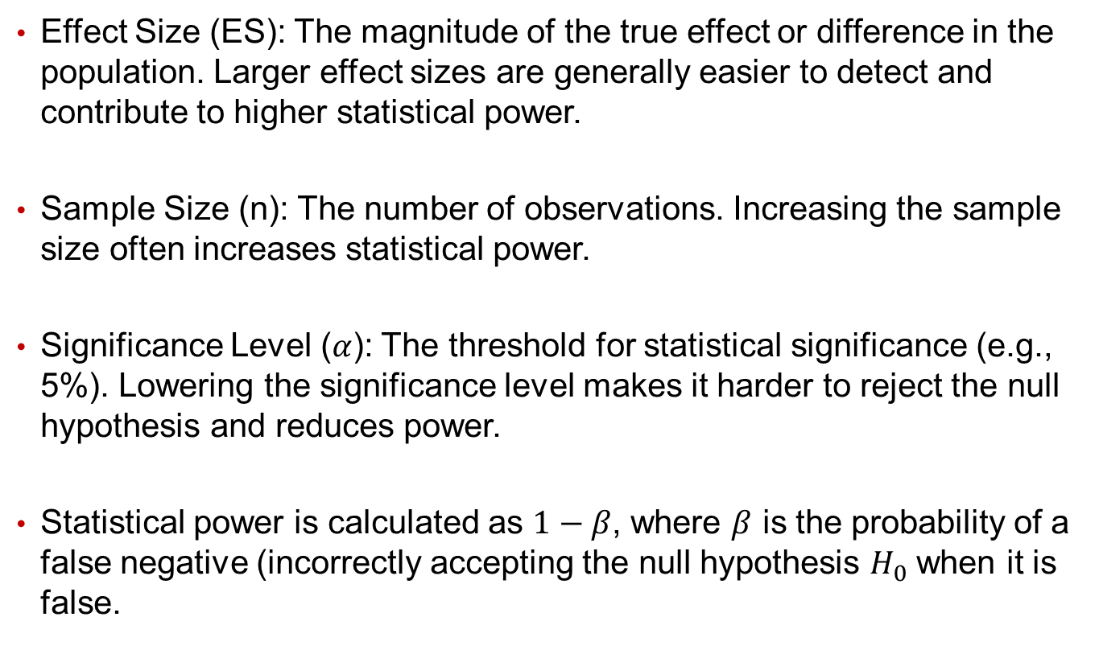
Elements of Statistical Power
Effect Size (ES): The magnitude of the true effect or difference in the population. Larger effect sizes are generally easier to detect and contribute to higher statistical power.
Sample Size (n): The number of observations. Increasing the sample size often increases statistical power.
Significance Level ($α$): The threshold for statistical significance (e.g., 5%). Lowering the significance level makes it harder to reject the null hypothesis and reduces power.
Statistical power is calculated as $1−β$, where $β$ is the probability of a false negative (incorrectly accepting the null hypothesis $H_{0}$ when it is false.

Slide 6
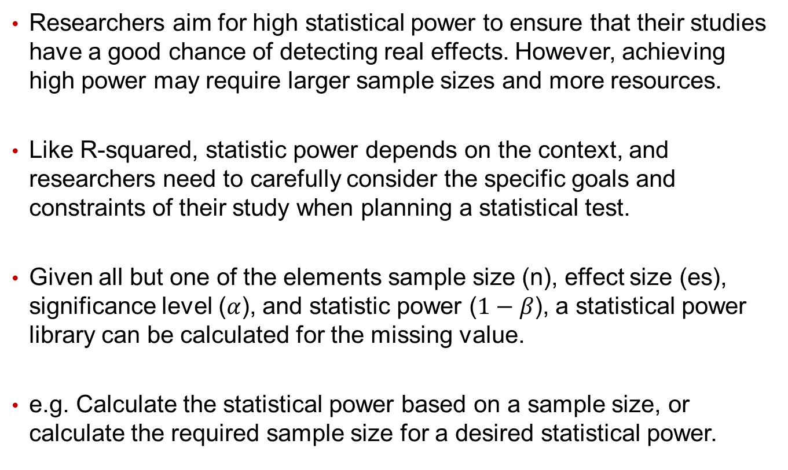
How Much Statistical Power Is Needed?
Researchers aim for high statistical power to ensure that their studies have a good chance of detecting real effects. However, achieving high power may require larger sample sizes and more resources.
Like R-squared, statistic power depends on the context, and researchers need to carefully consider the specific goals and constraints of their study when planning a statistical test.
Given all but one of the elements sample size (n), effect size (es), significance level ($α$), and statistic power ($1−β$), a statistical power library can be calculated for the missing value.
e.g. Calculate the statistical power based on a sample size, or calculate the required sample size for a desired statistical power.

Slide 7
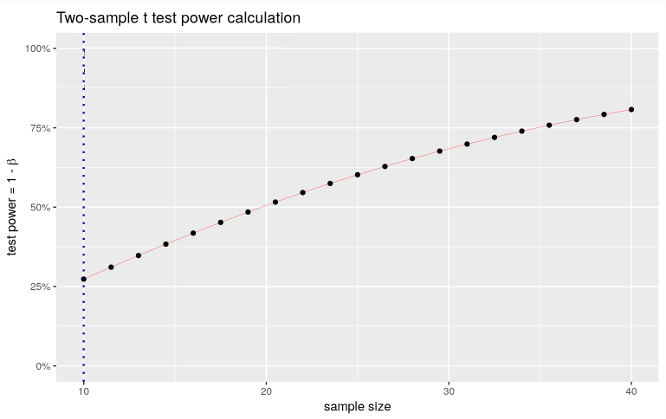
Statistical Power and Sample Size
An example:

Slide 8
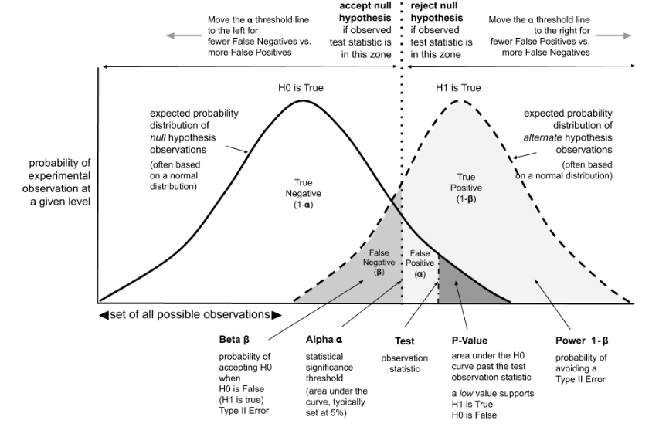
Appendix: Graphical Interpretation of Statistical Power

Slide 9
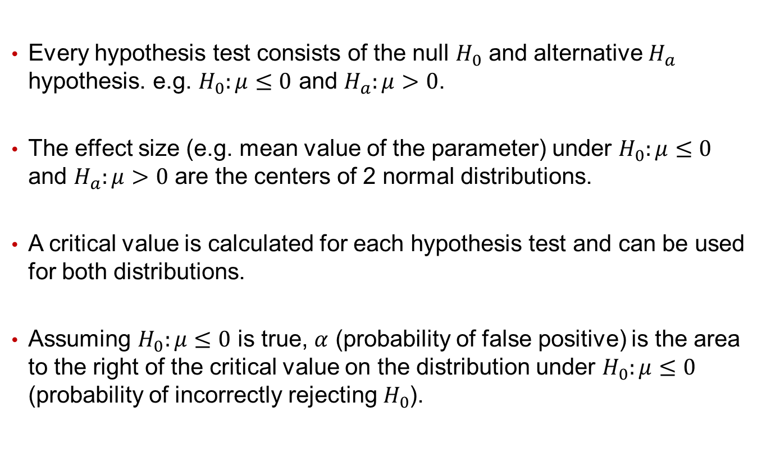
Appendix: Graphical Interpretation of Statistical Power
Every hypothesis test consists of the null $H_{0}$ and alternative $H_{a}$ hypothesis. e.g. $H_{0}:μ≤0$ and $H_{a}:μ>0$.
The effect size (e.g. mean value of the parameter) under $H_{0}:μ≤0$ and $H_{a}:μ>0$ are the centers of 2 normal distributions.
A critical value is calculated for each hypothesis test and can be used for both distributions.
Assuming $H_{0}:μ≤0$ is true, $α$ (probability of false positive) is the area to the right of the critical value on the distribution under $H_{0}:μ≤0$ (probability of incorrectly rejecting $H_{0}$).

Slide 10
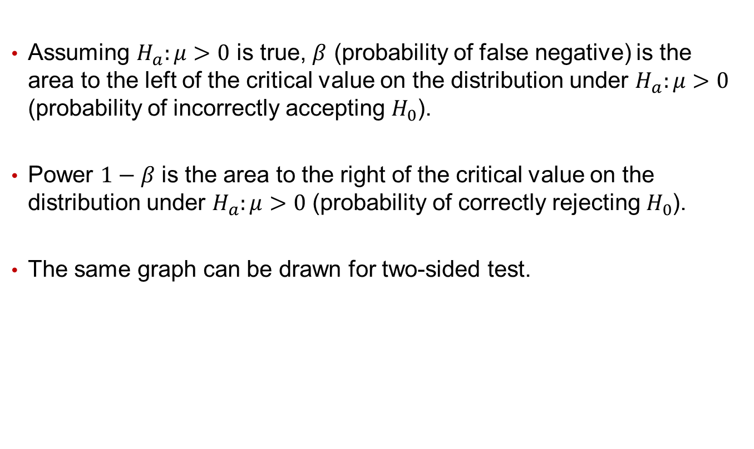
Appendix: Graphical Interpretation of Statistical Power
Assuming $H_{a}:μ>0$ is true, $β$ (probability of false negative) is the area to the left of the critical value on the distribution under $H_{a}:μ>0$ (probability of incorrectly accepting $H_{0}$).
Power $1−β$ is the area to the right of the critical value on the distribution under $H_{a}:μ>0$ (probability of correctly rejecting $H_{0}$).
The same graph can be drawn for two-sided test.

